Slide 1


Elastic block volumes

Slide 2
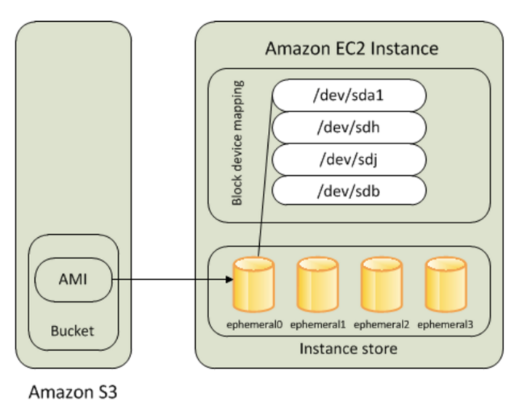
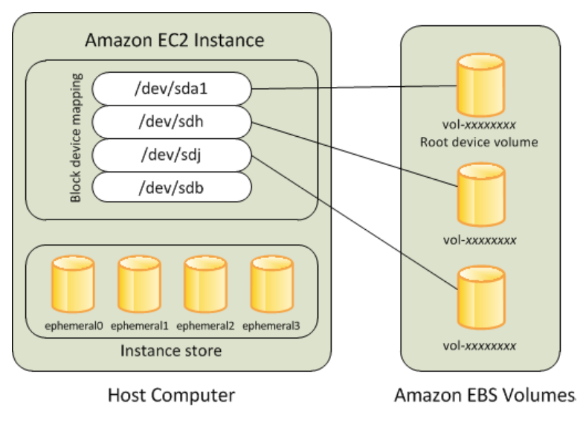
instance stores vs volumes

Slide 3
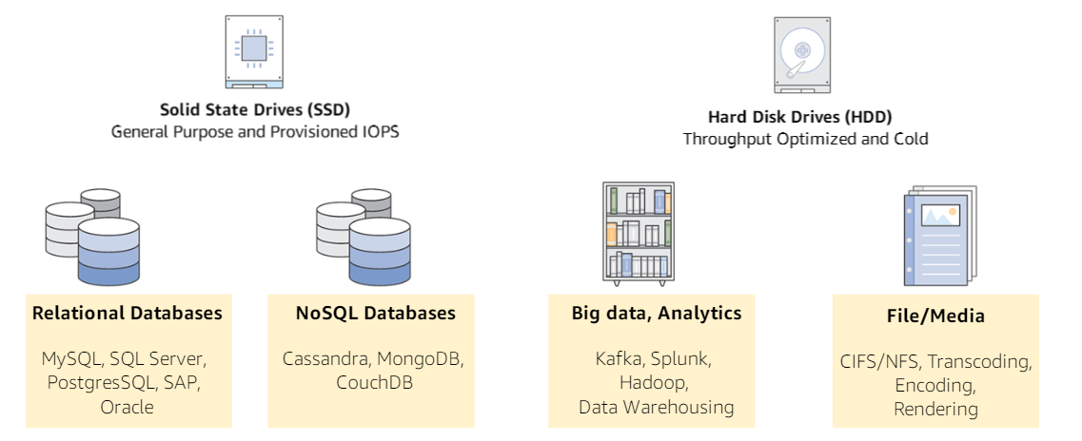
volumes

Slide 4
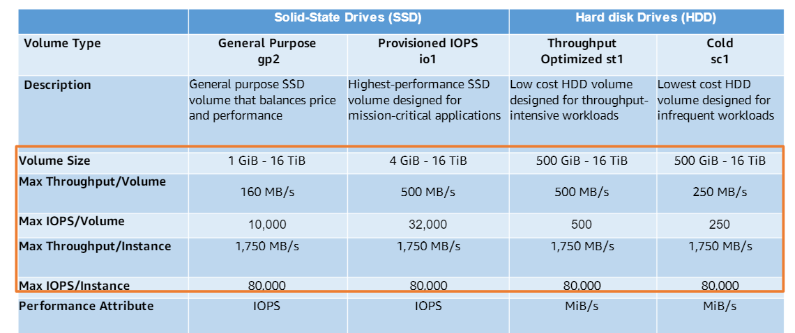
Volumes types

Slide 5
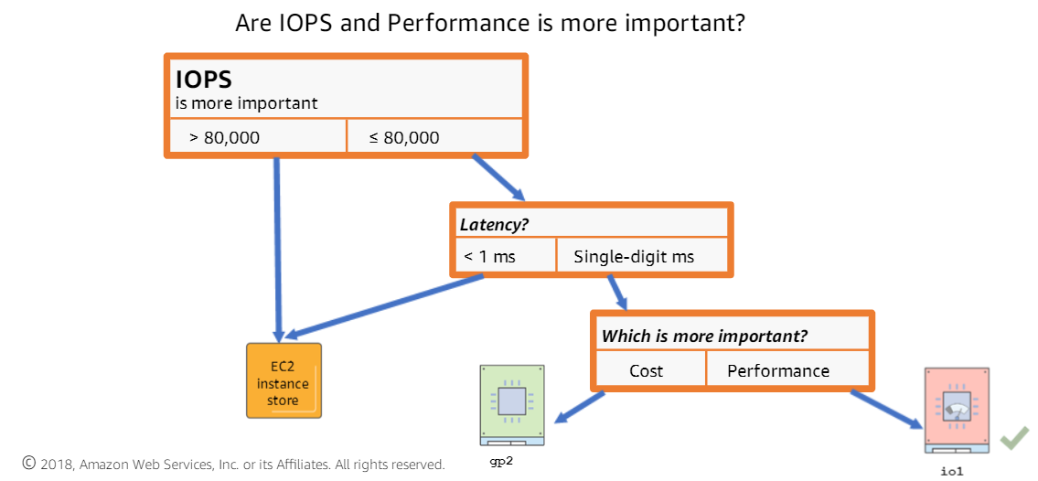
Volumes decision making

Slide 6
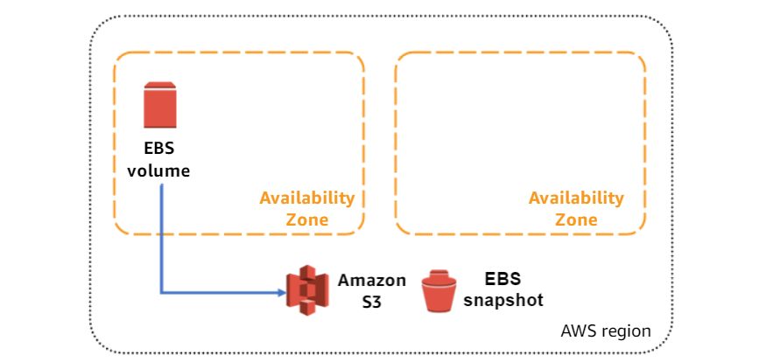
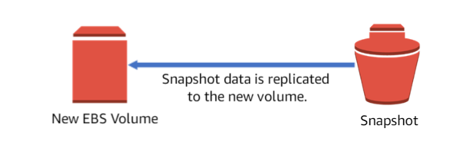
snapshots

Slide 7
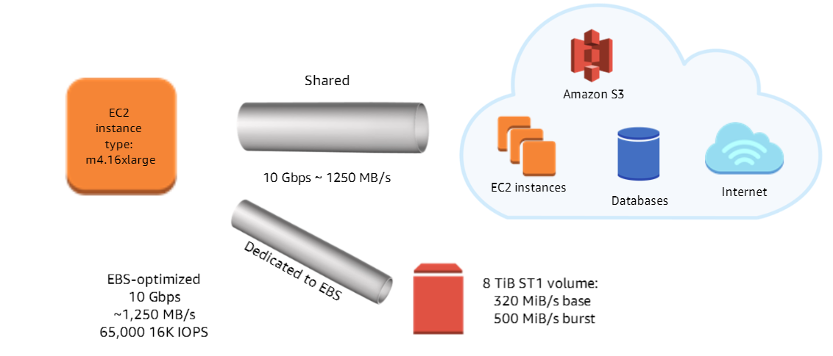
Ebs optimized instances

Slide 8
Snapshots process

Slide 9
Life cycle manager

